Slide 1


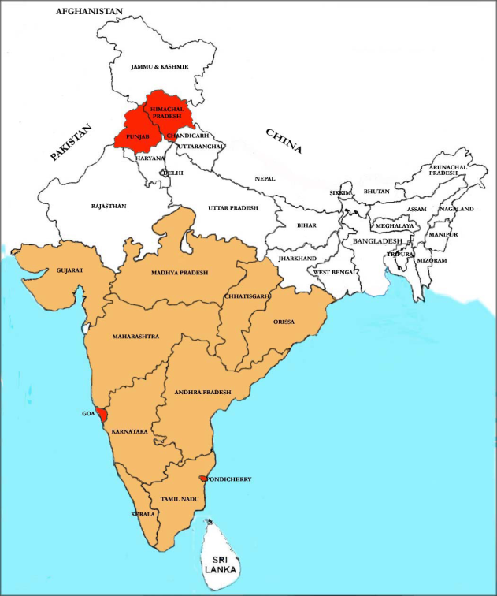
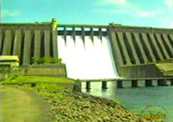
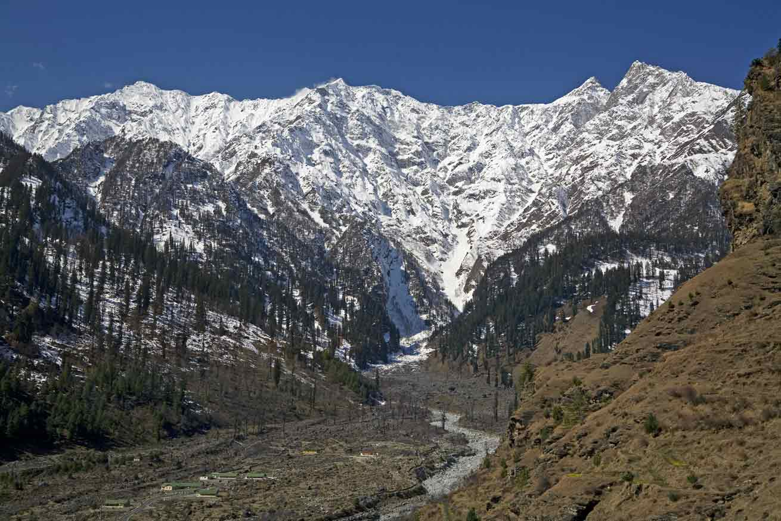
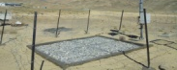
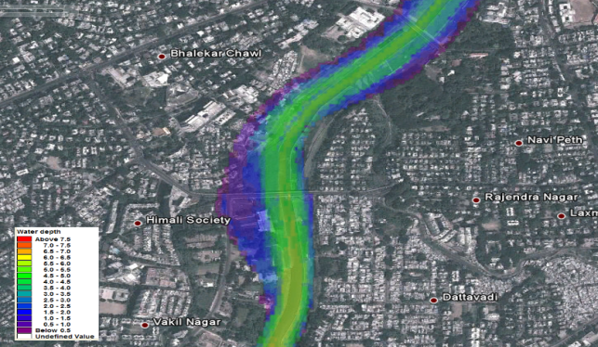
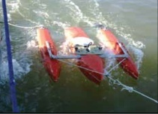
Hydrology Projects (A Journey)
INDIA
Map not to scale
On Going States
New States
'If You Can't Measure It, You Can't Manage It‘
(www.indiawrm.org)
RELIABLE, TIMELY, QUALITY, CONSISTENT, PUBLIC DATA

Slide 2
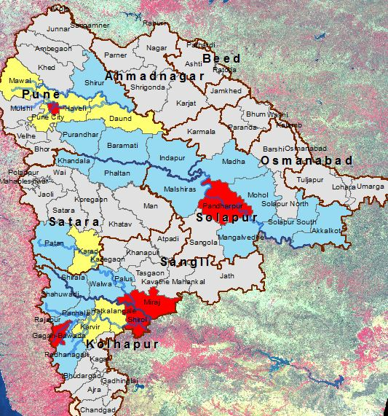
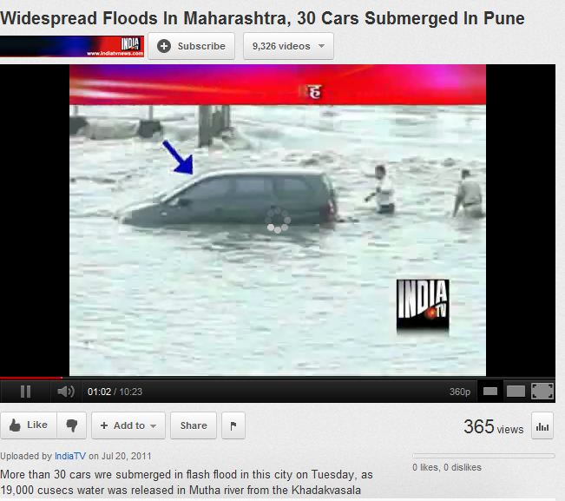
Flood disasters in Maharashtra
Maharashtra: Krishna-Bhima basins floods 2006
Districts | Total Loss 2006 INR (Crore) | Human losses
Satara | 54 | 23
Sangli | 99 | 19
Kolhapur | 238 | 26
Total | 393 | 78

Slide 3
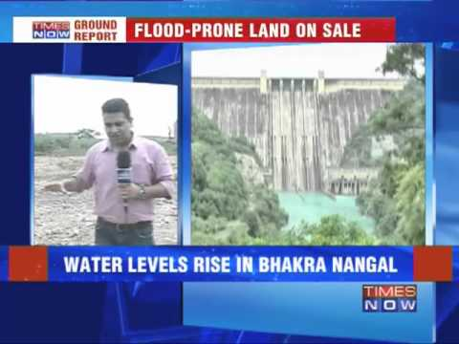
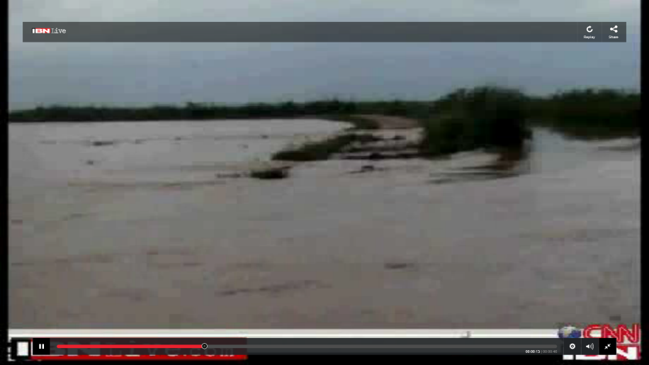
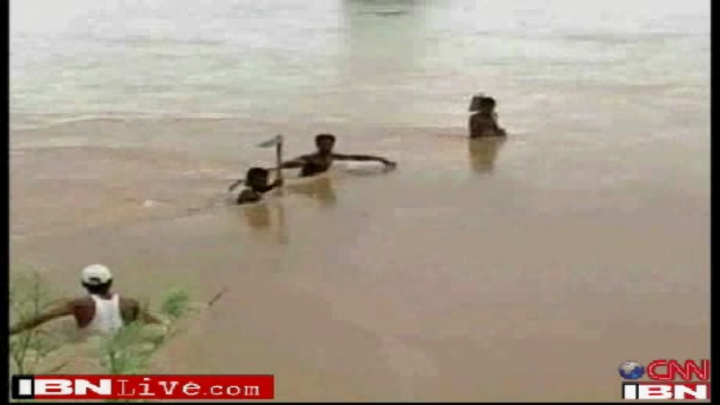
Floods in Bhakra –Beas System
The flood damage across the country are in the range of INR 6000 crore/year
Bhakra-Beas System
Storage > 18.19 BCM
Hydropower = 2877 MW
(~INR 9000 crore)
Gross command area = 2.68 M ha
Year | Inflow (MCM) | Total Loss (INR Crore)
2007-10 | 11,181-16,354 | 54 -239
2013 (post project) | 15,391 | No loss

Slide 4
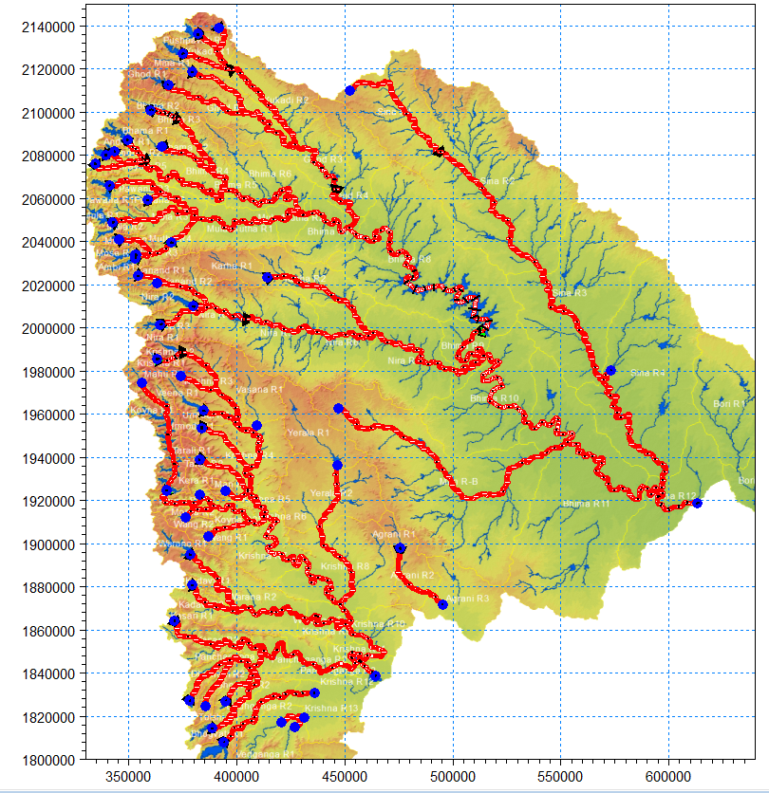

Reservoir operation system
Large number of reservoirs: 46 major and medium reservoirs
Tendency is to keep the reservoirs full towards the end of rainy season.
When heavy rain occurs, the reservoirs are operated releasing sudden flows causing damaging floods in downstream. Because reservoir operators hardly get lead time of 4-5 hours for operation.
Now reservoir operators have online flood forecast system (lead time) of more than 3 days and the losses will be minimized through “technology based” reservoir operation system.

Slide 5
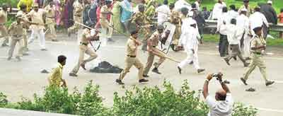
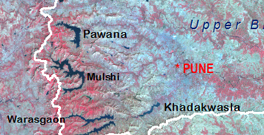
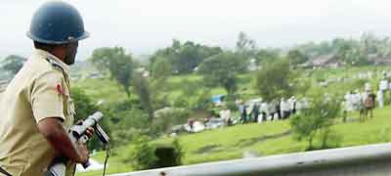
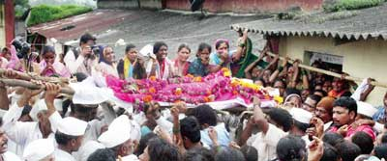
Reservoir operation: Who is first: Drinking,
Industry or Agriculture?
Farmers protest over proposed pipeline from Pawana reservoir to industrial area near Pune
Three killed in the riots, 25 policemen injured

Slide 6
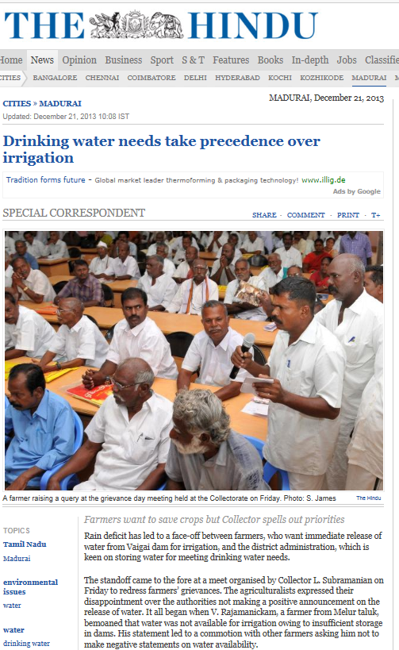
Inter-sectoral Demand
Drinking and Agriculture
Increasing Drinking and industrial demands are at the cost of agricultural water, hence require improved water use efficiency and information to the farmers for proper crop planning.
Government has planned to invest a large sum of money for Agriculture and Water Resources Development under 12th Five Year Plan.

Slide 7
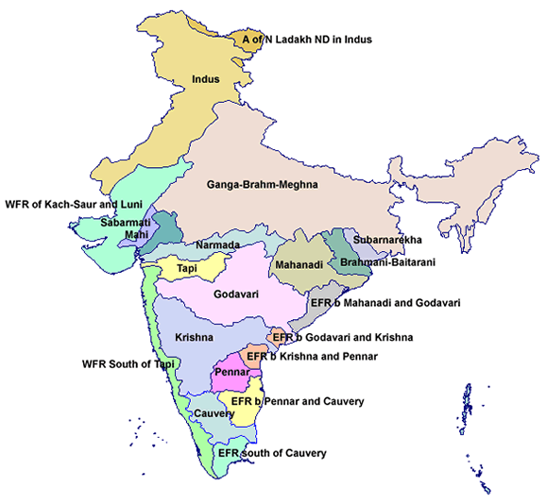
Is information really updated to manage all these issues?
Assessment as of 1993
20 Major River Basins
Rainfall 4000 BCM
River runoff 1869 BCM
  Surface Water 690 BCM
  Ground water 433 BCM
  Total available 1123 BCM
Uncertainty in Water resources assessment due to insufficient monitoring system
1 BCM is enough to serve Delhi for 1.5 year.
Climate change: Impact on Water resources Availability in Space and Time is not available?

Slide 8
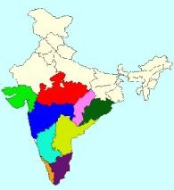
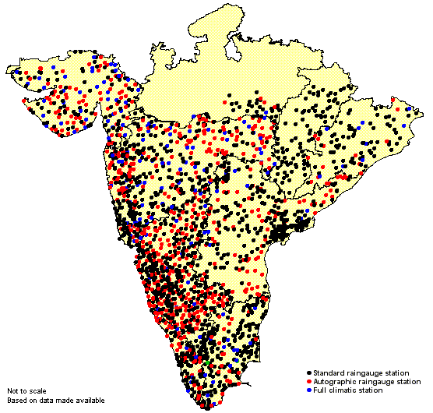

World Bank aided HYDROLOGY PROJECT
(1995-2003) SDR 70.79 M Hydrology Project-I (HP-I) was taken up to develop Hydrological Information System (HIS) for collecting hydrological, meteorological and water quality data.
(2006-2014) USD 104.98 M HP-II was taken up to extend and promote the use of HIS
by all potential users concerned with the Water Resources Planning and Management, both in public and private, thereby contributing to improve productivity and cost effectiveness of water related investments.
INDIA
Nine States
Map not to scale
13 States
HP-1 States
New States

Slide 9
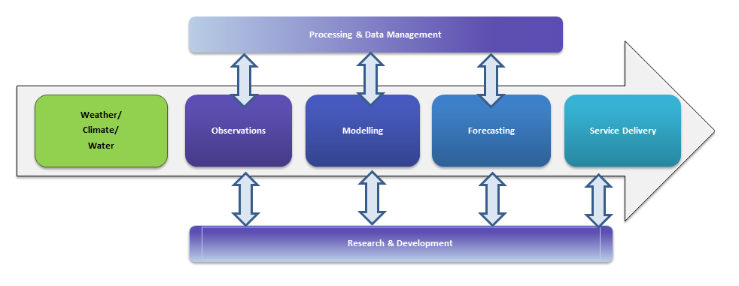
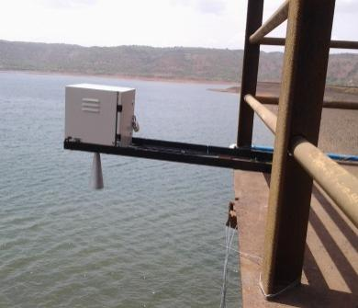
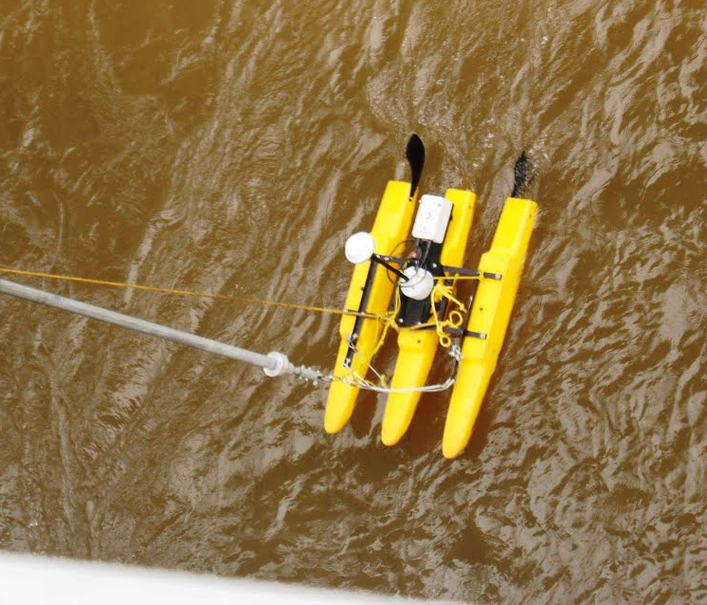
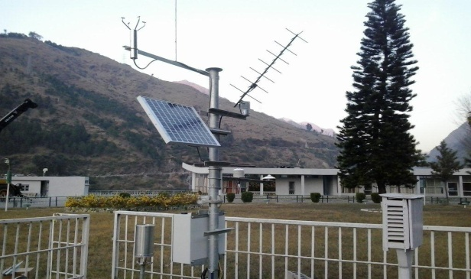
Measurement - starting point to scientifically informed solutions

Slide 10






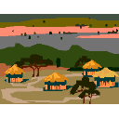


















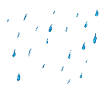
A Typical River Basin…
Agriculture Department
Precipitation
Livestock Department
Forest Department
Rural Water Supply Department
Fishing
Hydropower
Forest
Urban Water Supply Department
Reservoir
Irrigation Department
Evaporation / Transpiration
Runoff
Power Department
Industry
River Basin Boundary
Urban WSS
Industry Department
Rural WSS
Rainfed Agr
Fisheries Department
Return Flow
Irrigation
Recreation
Groundwater Inflow
Environment Department
Community Use
Transport Department
Navigation
Tourism Department
Infiltration / Recharge
Livestock
Wetlands / Environment
Groundwater Department
Base Flow / Pumping
Surface Water Department
Groundwater
Ocean Development/CZM Department
Trans-boundary Water Institutions
Irrigation
…there is a need to share information and integrate the activities of multiple actors…
Groundwater Outflow
Ocean

Slide 11
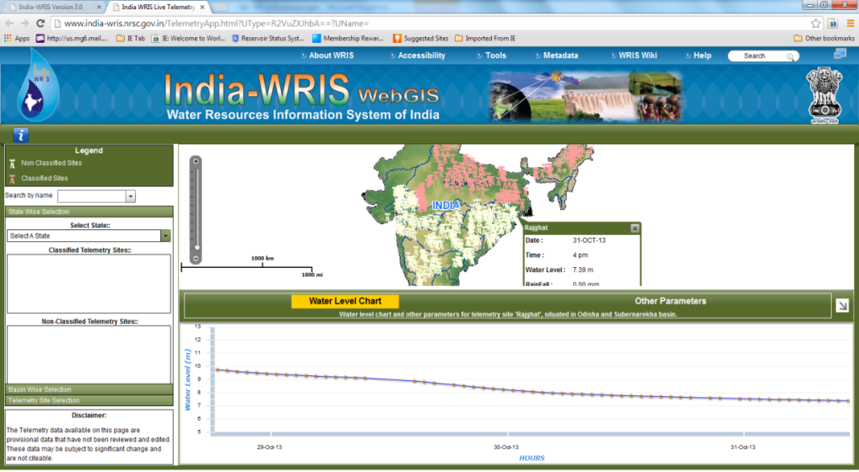
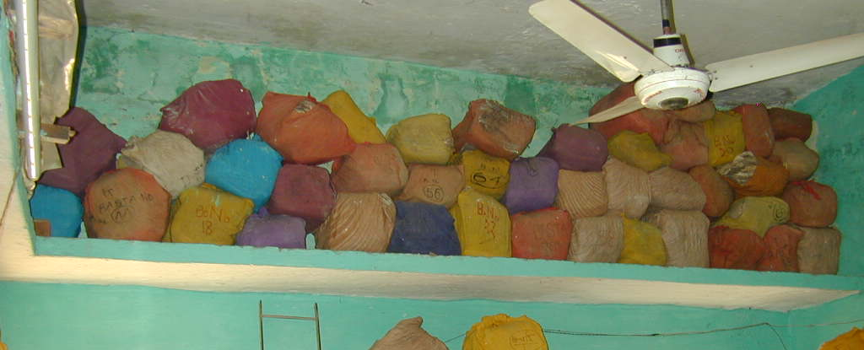
Transforming Water Information in to Digital form
Problem
Project Intervention
Example Outcome
Detailed Assessment of water availability is not available and outdated.
States are equipped with their own hydro-met data and are producing detailed assessment.
Standardized online data entry and storage system
  Extended Monitoring system
  Digitized maps and other information
  Strengthened/ Established Hydrology data centers and trained the staff
Not enough capacity in States in Hydrological monitoring
Data is not accessible

Slide 12
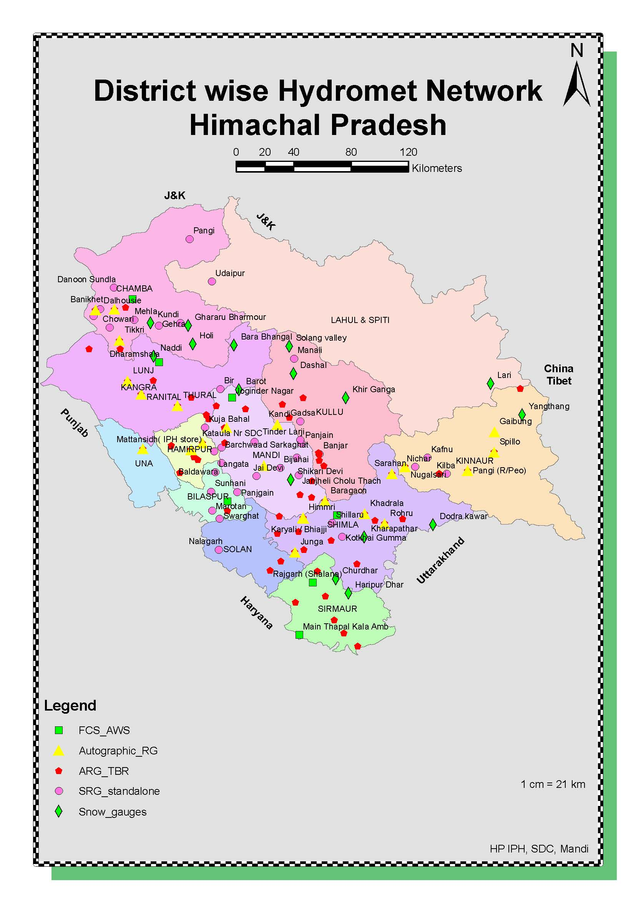
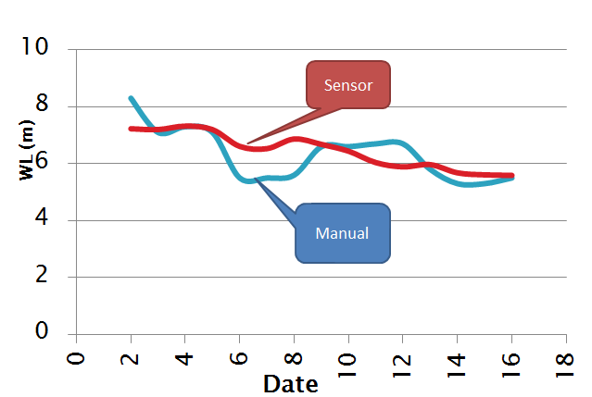
Reliable, timely and consistent Water information
Problem
Project Intervention
Example Outcome
Manual data not reliable
  Real time /automated Hydro-met installed.
Reliable and timely data available: online with access to public in many states
Not accessible and time consuming

Slide 13

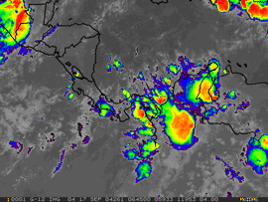

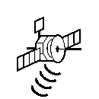
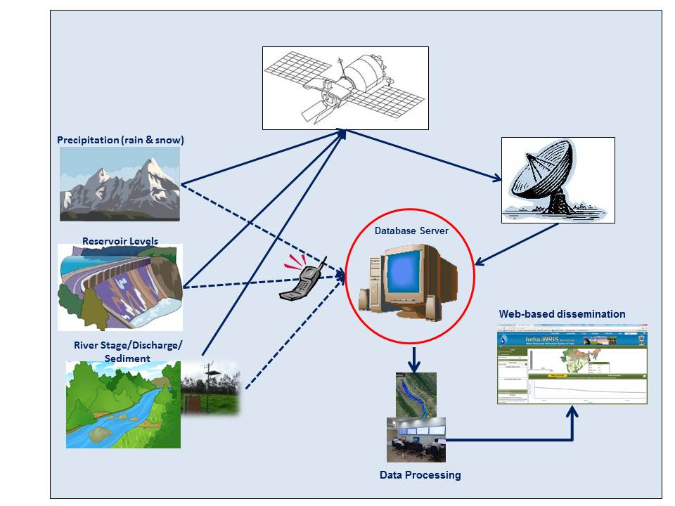


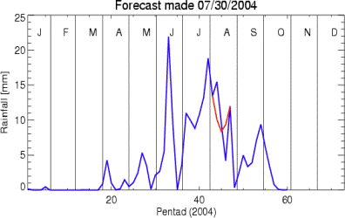

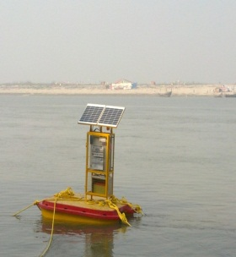



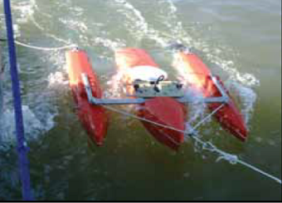
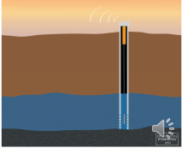
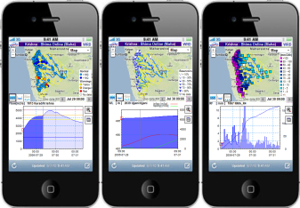
Data Generation
Bottom-up+Top-down
REAL TIME HYDRO-MET SYSTEM
Satellite based Climate
Data Transmission
(e.g. Satellite-InSAT, V-SAT, Cellphone)
Precipitation (rain & snow)
Reservoir Levels
Water Quality
Internet/ Intranet
River and Canal Stage/
Discharge/Sediment
Groundwater
Data Visualization & Use

Slide 14
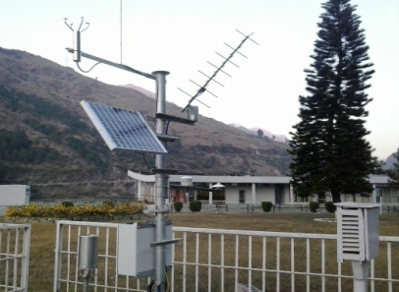
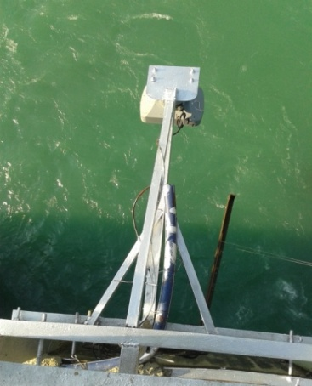

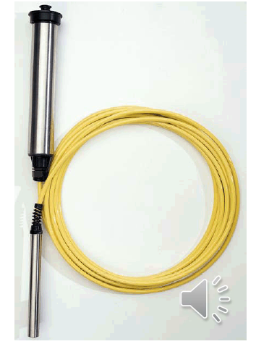
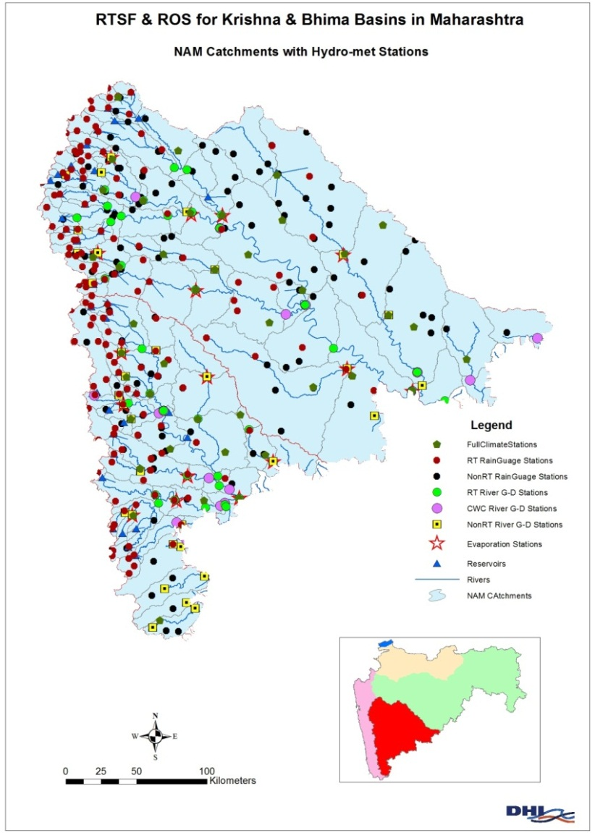
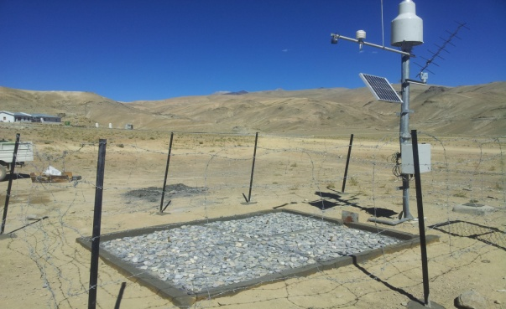

Real time /Automated Hydro MET
Automatic Weather Stations
Water Level Recorder
Water Quality Station
Digital GW Recorder
Snow Pillows
River Flow
  Output:
  - Reliable and timely data in several states of India
  - Saving in operating cost by 50% of manual cost.
14

Slide 15
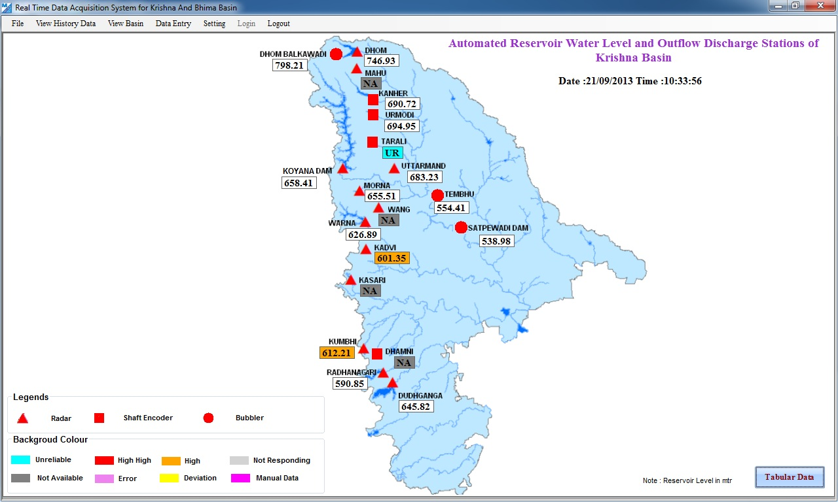

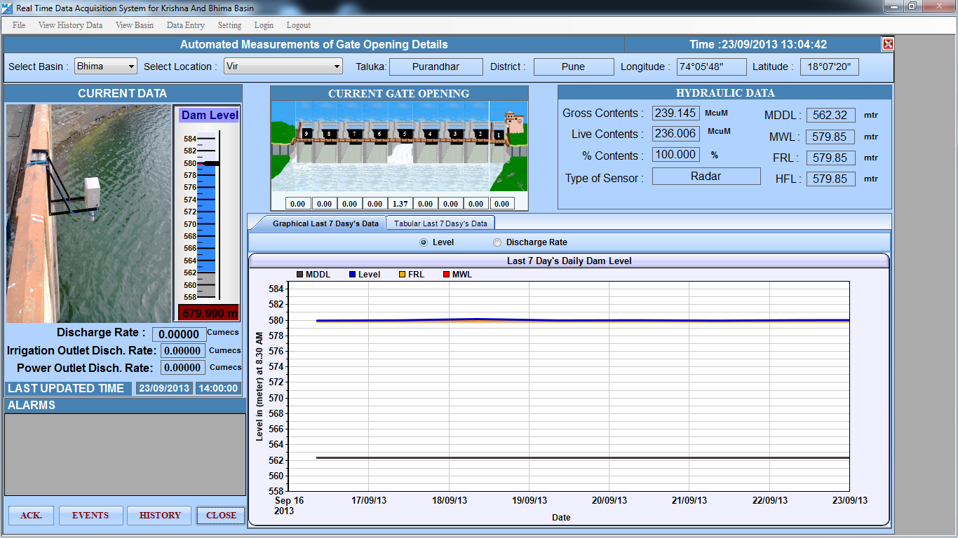
Maharashtra
Real Time Hydro-met 237 stations
www.rtsfros/krishna/source/krishna.htm

Slide 16
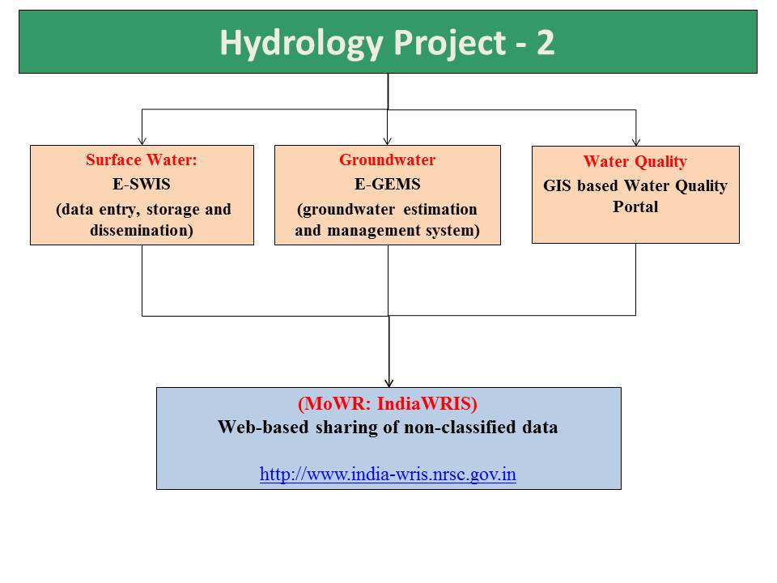
Web-Based Water Resources
Information System
Advantages:
Standardized database with reliable, transparent and timely access to data.
Expedite Plan Preparation for water investments using state owned data.
Enhance exchange among state and central agencies at real time to make decisions at river basin level in particular for flood management and reservoir operation.
Maharashtra, Karnataka, Tamil Nadu, Puducherry are sharing data in public

Slide 17
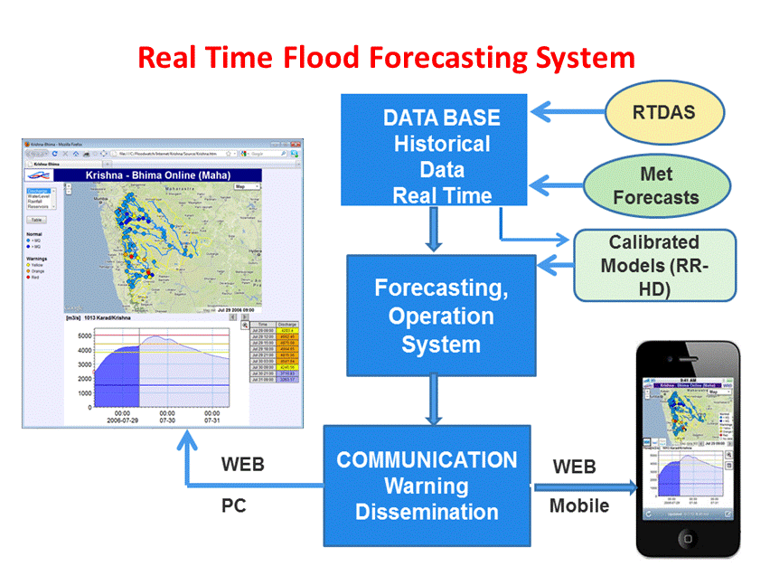

Making information travel faster than flood water
Problem
Project Intervention
Example Outcome
Sudden releases from Reservoir causing floods in downstream
Lead time improved from hours to days.
No sudden releases and hence savings (100’s of crores) due to reduced flood damages.
  Flood forecasting system and reservoir operation system
The time available for operation of reservoirs is very short (hours for Upstream reservoirs)

Slide 18
Flood Forecasting & Early Warning System
Data Collection
Transmission
& Reception
As quickly as possible
Making information travel faster than flood water
Forecasts
To save lives
To minimize damage
To reduce risk
Dissemination
As much time as possible before flood start
Emergency Response

Slide 19
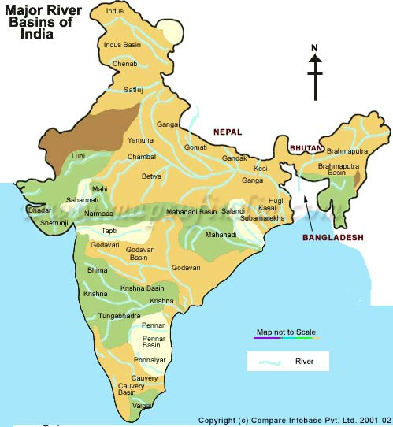
Flood Management
  Developed Stream Flow Forecasting and Reservoir Operation
  Systems for Flood Management in 2 River Systems
Bhakra – Beas Basin
Upper Krishna & Bhima Basin

Slide 20
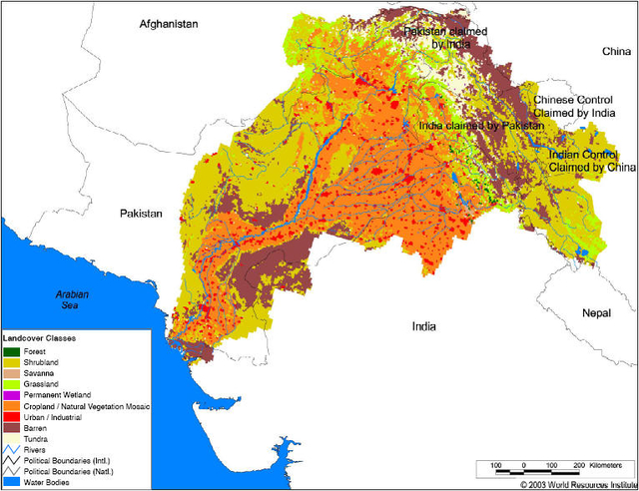
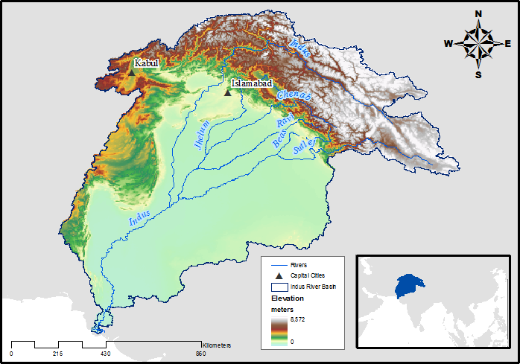
Water does not follow the administration boundary and
so is water information
Problem
Project Intervention
Example Outcome
Data across the country is not freely available
Improved spatial assessment of Snowmelt, rainfall and climate forecast including the areas outside the country.
  Satellite based information
Monitoring systems are not enough

Slide 21



Satellite based information has no
administrative boundaries
Satellite Precipitation (TRMM)
Snow Cover and temperature (MODIS)
Quantitative Precipitation Forecast from RIMES

Slide 22


Look up and down before any decision:
You are in a river basin!
Problem
Project Intervention
Example Outcome
Investment/
development program without any consideration to linkages between upstream and downstream users
  Decisions Support system for planning and management at River Basin scale
Improved design, cost effective and technically environmentally viable solutions
- IMPROVE LEAD TIME FROM HOURS TO DAYS
-MINIMIZE THE WASTAGE OF WATER
- MAXIMIZE THE ECONOMIC VALUE OF WATER
- EASY, EFFECTIVE AND EFFICIENT MANAGEMENT
OF THE RIVER SYSTEM, RESERVOIRS, HYDROPOWER AND THE
VARIOUS HYDROLOGIC STRUCT
Benefits of River Basin DSS

Slide 23

Improved Design and Investment
Improved planning, design and cost-effective water investment through development of Tools like Decision Support System (DSS) & Hydrological Design Aids (HDA)
  Examples
  Maharashtra (Water supply for Pune)
  Tunnel proposed to link two reservoirs upstream of Pune was stalled after because it was not found to augment the storage.
  Pipeline in place of open channel has lead to saving of 8.78 gigawatt hour/year and INR 3.8 Crore per year
Kerala
  Using GIS and DSS, located diversion system for flood in upstream of a city and minimized floods.
  Kerala assessed the feasibility of check dams for augmenting water supply to a major city and saved INR 15 Crores.

Slide 24



Real Time Water Quality Stations
in Yamuna and Ganga Basin
http://cpcb.rtwqms.com/
-
Used in managing water quality during Kumbh Fair served millions.
Based on this experiences, under the Ganga Project by NMCG, 111 Real Time Monitoring stations are being planned along the main stem of Ganga River
Using to monitor and manage water quality in Delhi

Slide 25

Groundwater Management
Aquifer Mapping carried out using advanced goephysical techniques including heliborne techniques - carried out first time in India.
Key highlights:
Several new techniques Piloted for the first time in the country.
Findings of the Pilot Project shall be a Major input to the National Project on Aquifer Mapping & Management (NAQUIM)
Faster and accurate in data acquisition.
Heliborne survey is found to be Cost effective compared to other methods for same number of data points.

Slide 26

Aquifer Mapping: CGWB and NGRI
Six Pilot sites (Area Sq Km)
Baswa-Bandikui Watershed, Dausa District, Rajasthan – I – AQRAJ | 598
Maner-Khagaul Area, Patna Dist, Bihar II – AQBHR | 521
Watershed Nagpur district, Maharashtra - III – AQMAH | 360
Parts of Tumkur District, Karnataka - IV – AQKAR | 376
Lower Vellar, Cuddalore district, Tamil Nadu - V – AQTND | 344
Part of Thar Desert, Jaisalmar District, Rajasthan. - VI – AQDRT | 675
http://aquiferindia.org

Slide 27
Key Highlights of Hydrology Project
Improved water resources assessment with the Hydro-met system: Introduction of real time Hydro-met for reliable and timely data.
Improved accessibility and dissemination to data by users: Web-Based software for Standardization of database.
Tool and applications for inter-sectoral water allocation, management and planning investment: Integrated river basin management system.
Flood Management: Early warning system and Reservoir operation system.

Slide 28
Major Achievements under Hydrology Project
Tangible and non tangible…!
National/Central/basin level
  Policy formulation
  Assessment
  Planning
  Design
  Management
  Reporting

Slide 29
Major Achievements under Hydrology Project
State/basin level
  State Water Plans and Policies Assessment
  Maharashtra – State Water Plan
  Karnataka – Ground Water Policy
  BBMB – signed an MoU for sharing data with upper riparian States

Slide 30
Major Achievements under Hydrology Project
State/basin level
  Real-Time Flood Forecasting and Reservoir Operation Systems.
  BBMB
  Avg. flood damage - Rs 105 crore/year, with an avg. of 23 lives lost per year and 250,000 people displaced (2007-10)
  Cost of DSS – Rs 37 crore
  Total inflow in 2013 as high as 1988 – but minimal damage

Slide 31
Major Achievements under Hydrology Project
State/basin level
  Real-Time Flood Forecasting and Reservoir Operation Systems.
  Maharashtra WRD
  flood damage in Krishna Basin - Rs 393 crore during 2006
  Cost of DSS – Rs 31 crore
  Manage as many as 46 reservoirs through the DSS developed.

Slide 32
Major Achievements under Hydrology Project
State/basin level
  Decision Support System (DSS) for Water Resources Development, Planning & Management.
  Karnataka-SW - HIS data for the planning of five water supply projects, six hydropower projects etc.
  Gujarat-SW - identified a number of check dams
  Guj-GW used HIS for minor irrigation in tribal areas
  Andhra Pradesh GW identified areas requiring canal lining, addressing water logging issues using HIS
  Mah SW used DSS-P for drought mitigation in Upper Godavari basin during 2013-14
  Guj SW used multi-reservoir operation facilities of DSS-P in Mahi river basin

Slide 33
Major Achievements under Hydrology Project
State/basin level
  Decision Support System (DSS) for Water Resources Development, Planning & Management.
  Karnataka Geomatics Center - application enabling the identification of optimum locations for new projects and industrial units based on water availability (basis – HIS).
  Karnataka SW - identified water logging and zones of water deficit in the Tungabhadra irrigation system
  Maharashtra SW - augmented water supplies in Pune
  Kerala SW - check dams to augment water supplies which are likely to result in savings of about Rs 15 crore

Slide 34
Major Achievements under Hydrology Project
State/basin level
  Real-time Water Quality Monitoring Systems
  CPCB installed 10 no. of Stations on Ganga
  CWC installed 3 no. of Stations
  For the first time in the country -
    Useful in online monitoring during Kumbh
    Early detection of ammonia in river Yamuna upstream of Wazirabad barrage
    Time, manpower and cost saving
    The list of achievements is quite long..! Several PDSs have been remarkable, the achievements of states of Himachal and Goa are also exemplary.

Slide 35
India Water Resources Management Programme – Hydrology Project (Phase – III)
RELIABLE, TIMELY, QUALITY, CONSISTENT, PUBLIC DATA

Slide 36
HYDROLOGY PROJECT – Journey Ahead
HP-I (1995-2003)
HP-II (2006-2014)
HP-III (2014 – ongoing)
INDIA
Map not to scale
On Going States
New States
9 States
6 Central Agencies
13 States
8 Central Agencies
Across All Indian States
and UTs
36

Slide 37
Philosophy of Hydrology Project –Phase III
Standardizing Water Resources Monitoring and Information System for the country with uniform procedures and database.
Enhancing collaboration between Centre & States.
Improving access to information in the public-domain.
Introducing country wide generic solutions for flood forecasting and water resources management.
Developing site specific solutions for water resources planning and management including use of remote sensing based techniques.
37

Slide 38

'If You Can't Measure It, You Can't Manage It‘
Thank you

